Slide 1



CREDIT CARD FRAUD DETECTION
By :- Deepak Singh.

Slide 2
USING MACHINE LEARNING CONCEPT
CONTENT
1 :- Introduction.
2 :- Dataset.
3 :- Datacleaning.
4 :- Using different model.
5 :- Checking accuracy.

Slide 3

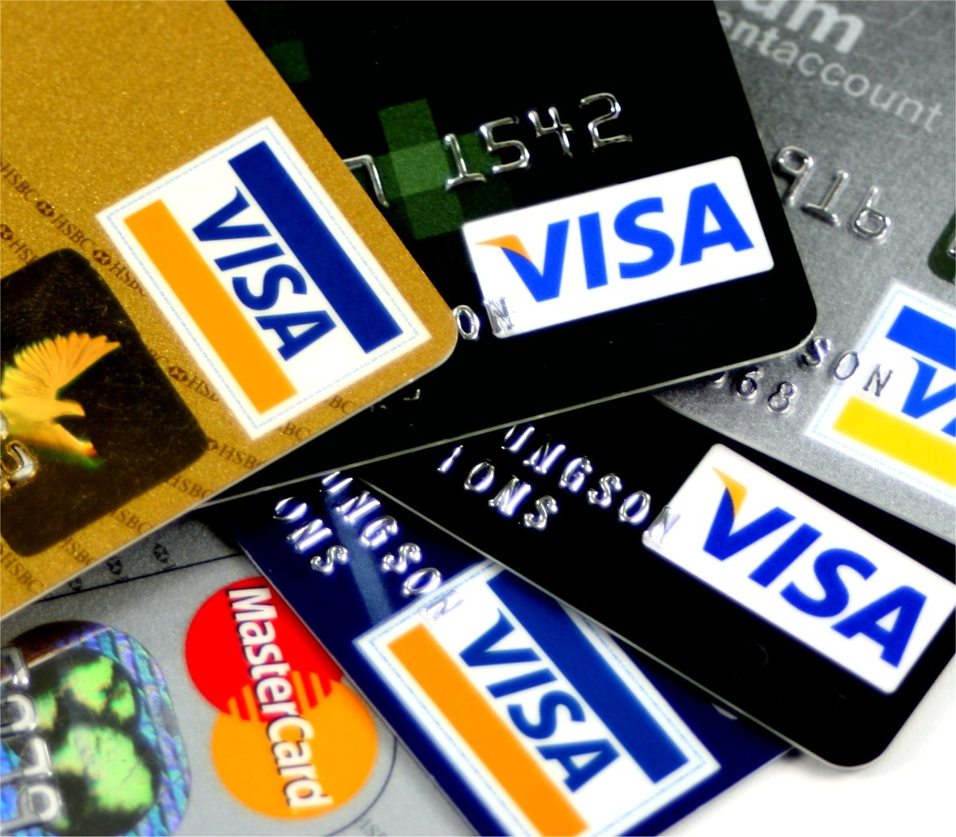
ABOUT
# In this project,we have built a machine learning model to predict the ‘Credit Card Fraud Detection’.
# This project will very helpful for the real estate market .

Slide 4

GOALS AND OBJECTIVES
1). When a fraudster compromises an individual's credit/debit card, everyone involved in the process suffers, right from the individual whose confidential data has been leaked to the businesses . The process of automatically differentiating between fraudulent and genuine users is known as “credit card fraud detection”.
2). I used creditcard data.csv dataset for creating model which i download from kaggle.com.
3). I am using multiple machine learning model to create a predictive model.

Slide 5
MODELS USED IN PROJECTS
1. LOGISTIC REGRESSION
2. RANDOM FOREST CLASSIFIER
3. GRADIENT BOOSTING LASSIFIER

Slide 6


ANALYSIS PART
# LOGISTIC REGRESSION = 94.41%
# RANDOM FOREST CLASSIFIER= 92.38 %
# GRADIENT BOOSTING CLASSIFIER = 91.37%
This Photo by Unknown Author is licensed under CC BY-SA

Slide 7



This Photo by Unknown Author is licensed under CC BY-NC-ND

